Slide 1
Figures & tables for the diagnosis papers
Last updated: Oct 12th, 2015
Tan H. Nguyen

Slide 3
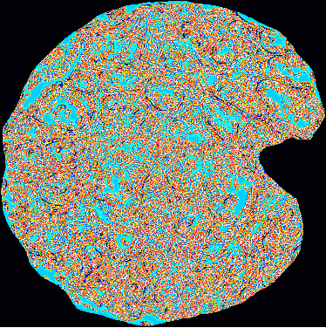
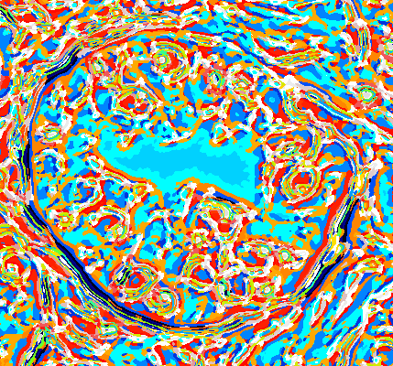
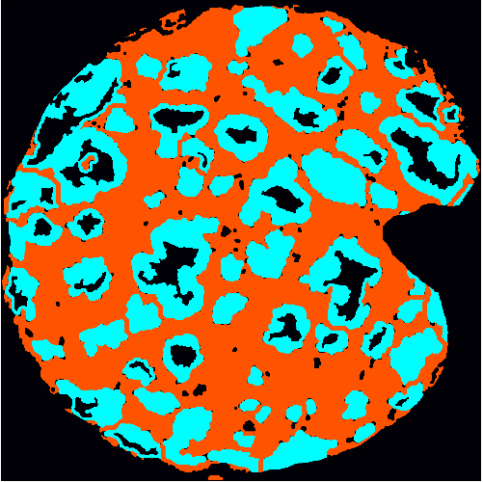
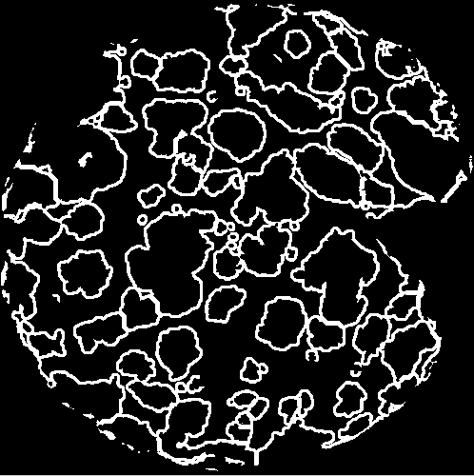


Histogram extraction
Texton index map for each pixel
Histogram of
texton indices
Classifier
$$r$$
Cancer/Non-cancer decision
Automatic segmented map
White: histogram computing region
Fig xx. How histogram of texton is extracted for cancer/non-cancer classification

Slide 4
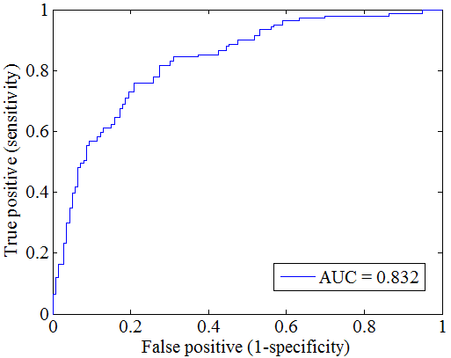
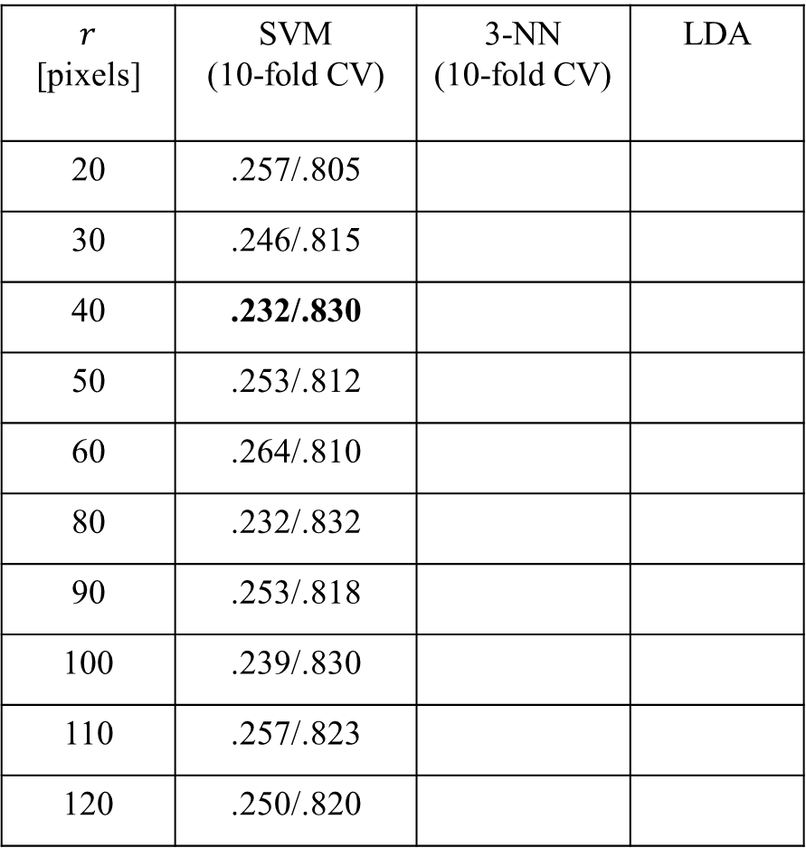
$r$ [pixels] | SVM (10-fold CV) | 3-NN (10-fold CV) | LDA
20 | .257/.805
30 | .246/.815
40 | .232/.830
50 | .253/.812
60 | .264/.810
80 | .232/.832
90 | .253/.818
100 | .239/.830
110 | .257/.823
120 | .250/.820
Fig xx+1. ROC curve for cancer detection with SVM and 10-fold cross-validation. Total number of samples: 280, cancers (G3 & G4): 141, non-cancers (NM, BPH, HGPIN):139
Table 1. Misclassification error./AUC for classifying between cancer (G3 & G4) vs benign (BPH, Normal & HGP)
after performing parameter optimization using grid search based on misclassification error

